Slide 1
Introduction to Number Theory

Slide 2
Division
If a and b are integers with a ≠ 0, we say that a divides b if there is an integer c such that b = ac (or equivalently, if b/a is an integer). When a divides b we say that a is a factor or divisor of b, and that b is a multiple of a. The notation a ∣ b denotes that a divides b. We write a ∤ b when a does not divide b.
We can express a ∣ b using quantifiers as ∃c (ac = b), where the universe of discourse is the set of integers.
Example : Determine whether 3 ∣ 7 and whether 3 ∣ 12.
We see that 3 ∤ 7, because 7∕3 is not an integer. On the other hand, 3 ∣ 12 because 12∕3 = 4.

Slide 3
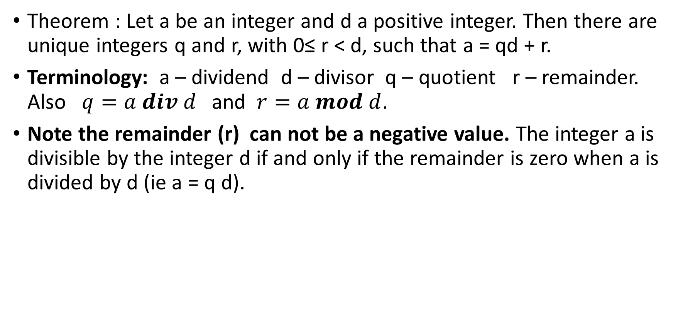
The Division Algorithm
Theorem : Let a be an integer and d a positive integer. Then there are unique integers q and r, with 0≤ r < d, such that a = qd + r.
Terminology: a – dividend d – divisor q – quotient r – remainder. Also $q=a div d$ and $r=a mod d$.
Note the remainder (r) can not be a negative value. The integer a is divisible by the integer d if and only if the remainder is zero when a is divided by d (ie a = q d).
When $a$ divides $b$ we say that $a$ is a factor or divisor of $b$, and that $b$ is a multiple of $a$ and is denoted by $a | b$.

Slide 4
Modular arithmetic
Division of an integer by a positive integer produces a quotient and a remainder. Working with these remainders leads to modular arithmetic, which plays an important role in mathematics and computer science.
Number theory studies the properties of integers Z = {0, ±1, ±2, . . .} and rational numbers Q = {p/q : p, q ∈ Z, q ≠ 0}

Slide 5
congruence
Definition: If a and b are integers and m is a positive integer, then a is congruent to b modulo m if m divides a − b.
We use the notation a ≡ b (mod m) to indicate that a is congruent to b modulo m.
We say that a ≡ b (mod m) is a congruence and that m is its modulus (plural moduli).
If a and b are not congruent modulo m, we write a ≢ b (mod m).

Slide 6
Example
What are the quotient (101 div 11) and remainder (101 mod 11) when 101 is divided by 11?
We have 101 = 11 ⋅9+2.
Hence, the quotient when 101 is divided by 11 is 9 (101 div 11),
The remainder (101 mod 11) is 2
The notation used to express the quotient (q) and the remainder(r) when a = dq + r :
q = a div d,
r = a mod d

Slide 7
Example
What are the quotient and remainder when −11 is divided by 3?
-11 = 3 (-4) + 1 (not -11 = 3 (-3) - 2 )
Quotient = -11 div 3 = -4
Remainder = -11 mod 3 = 1

Slide 8
Theorem
Let a and b be integers, and let m be a positive integer.
Then a ≡ b (mod m) if and only if a mod m = b mod m.
a mod m and b mod m are the remainders when a and b divided by m
Let a ≡ b (mod m) then a –b = k m for some integer k .
Let a = q₁m +r₁ and b = q₂m +r₂ where r₁ and r₂ are less than m.
Since a –b = km q₁m +r₁ - (q₂m +r₂) = k m
r₁ - r₂ = m (k - q₁ + q₂ )
r₁ - r₂ is a multiple of m and both r₁ and r₂ are less than m
r₁ - r₂ = 0 x m = 0
r₁ = r₂
that is a mod m = b mod m.

Slide 9
Theorem ……………….
Now Let a mod m = b mod m = r
Then a = q1m +r and b = q2m +r
a – b = m (q1 - q2)
a – b is a multiple of m or m divides a-b.
That is a ≡ b (mod m)

Slide 10
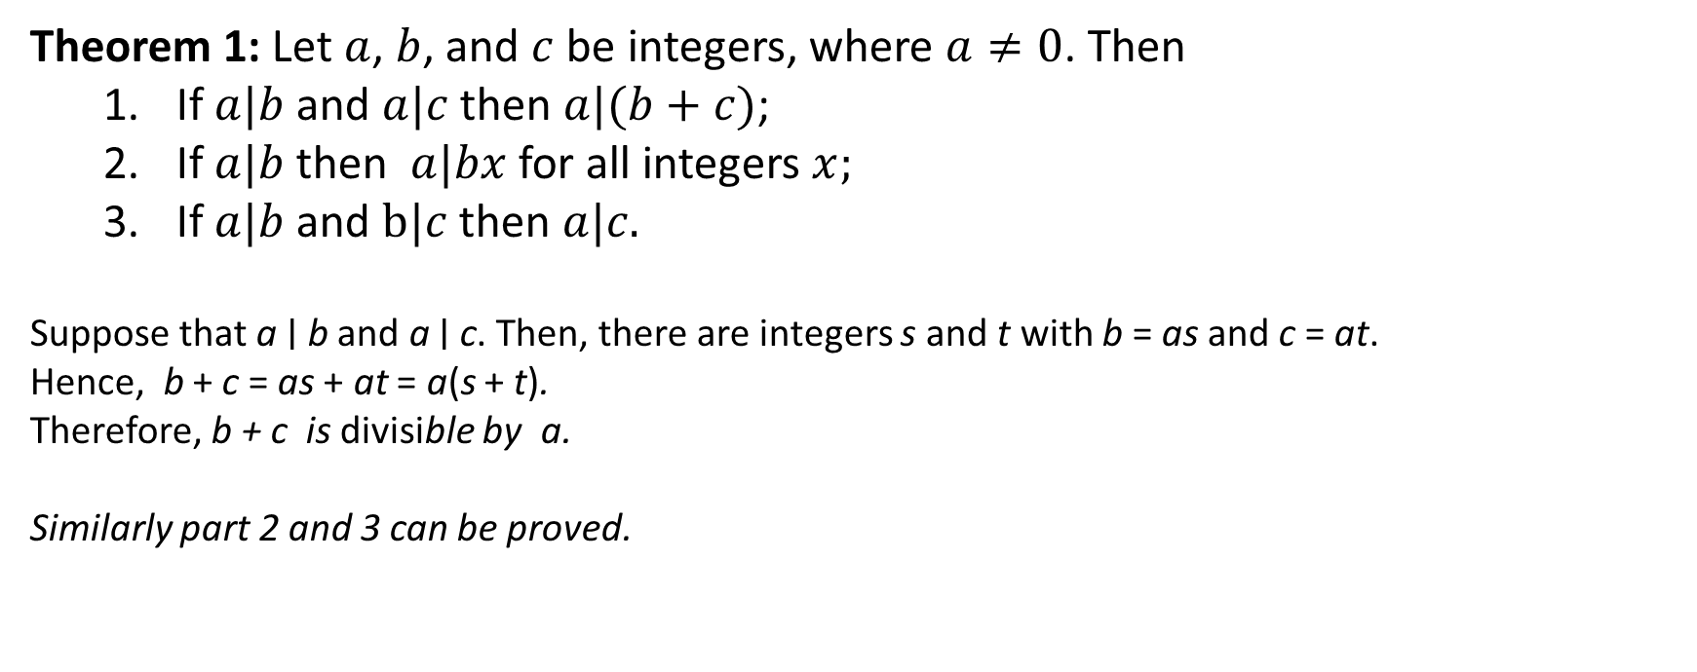
Basic Facts About Division
Theorem 1: Let $a$, $b$, and $c$ be integers, where $a≠0$. Then
If $a|b$ and $a|c$ then $a|(b+c)$;
If $a|b$ then $a|bx$ for all integers $x;$
If $a|b$ and $b|c$ then $a|c.$
Suppose that a ∣ b and a ∣ c. Then, there are integers s and t with b = as and c = at.
Hence, b + c = as + at = a(s + t).
Therefore, b + c is divisible by a.
Similarly part 2 and 3 can be proved.

Slide 11
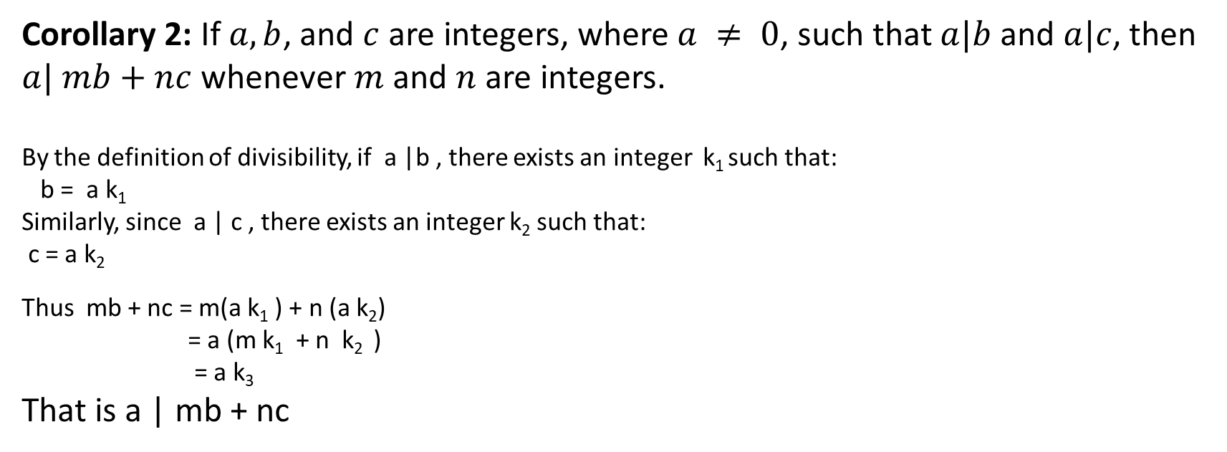
Basic Facts About Division
Corollary 2: If $a, b$, and $c$ are integers, where $a ≠ 0$, such that $a|b$and $a|c$, then $a| mb+nc$whenever $m$ and $n$ are integers.
By the definition of divisibility, if a |b , there exists an integer k₁ such that: b = a k₁
Similarly, since a | c , there exists an integer k₂ such that: c = a k₂
Thus mb + nc = m(a k₁ ) + n (a k₂)
= a (m k₁ + n k₂ )
= a k₃
That is a | mb + nc

Slide 12
Modular Arithmetic
If a is congruent to b module m ($a≡b (mod m))$then b is congruent to a modulo m $(b ≡a \left(mod m\right))$.
Example: Determine whether 17 is congruent to 5 modulo 6.
17 = 5 mod 6 ?
17 – 5 = 12 = 6 * 2 hence 17 is congruent to 5 modulo 6.

Slide 13
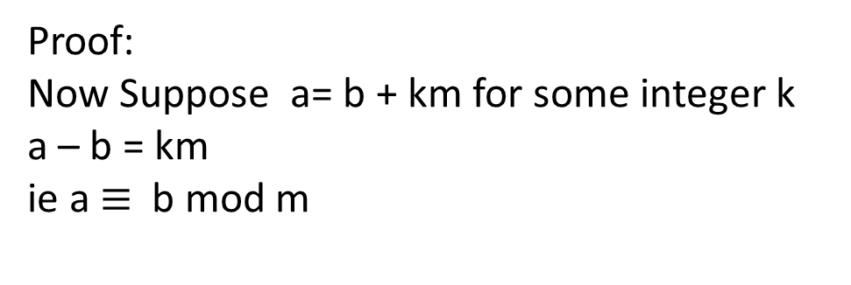
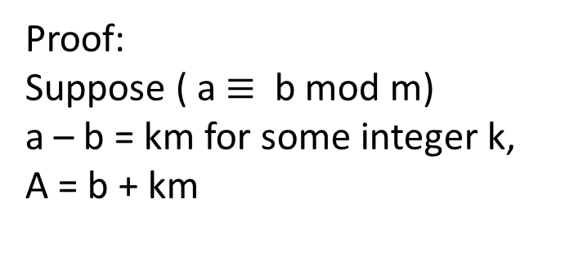
Some Basic Results
Definition: If $a≡b (mod m)$, then $b$ is a residue of $a modulo m$. When $0≤b<m$, then b is called the least non-negative residue of a modulo m.
Theorem 5: Let $m$ be a positive integer. The integers $a$ and $b$ are congruent modulo $m$ ( a $≡$ b mod m) if and only if there is an integer $k$ such that $a=b +km$.
Proof:
Suppose ( a $≡$ b mod m)
a – b = km for some integer k,
A = b + km
Proof:
Now Suppose a= b + km for some integer k
a – b = km
ie a $≡$ b mod m

Slide 14
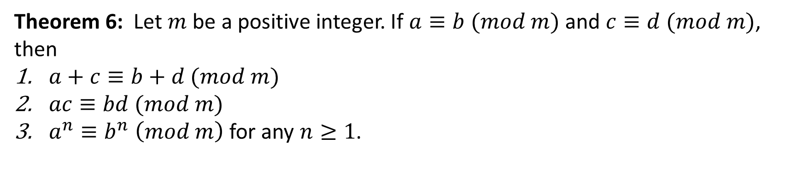
Some Basic Results
Theorem 6: Let $m$ be a positive integer. If $a≡b (mod m)$ and $c≡d (mod m)$, then
$a+c≡b+d (mod m)$
$ac≡bd (mod m)$
$a^{n}≡b^{n} \left(mod m\right)$ for any $n≥1$.

Slide 15
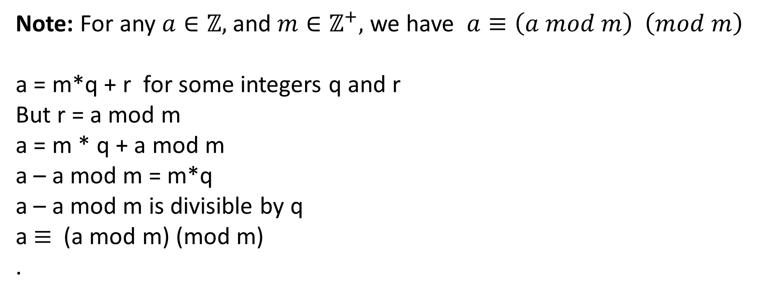
Example
Note: For any $a∈ℤ,$and $m∈ℤ^{+},$ we have $a≡\left(a mod m\right) \left(mod m\right)$
a = m*q + r for some integers q and r
But r = a mod m
a = m * q + a mod m
a – a mod m = m*q
a – a mod m is divisible by q
a $≡$ (a mod m) (mod m)
.

Slide 16

Some Applications of Theorem 6
$4^{2}≡3 mod 13$;
$4^{4}≡3^{2}=9 ≡−4 mod 13$;
$4^{8}≡{\left(−4\right)}^{2}≡16≡3 mod 13$;
$4^{16}≡3^{2}≡9≡−4 mod 13$;
$4^{32}≡{\left(−4\right)}^{2}≡16≡3 mod 13$;
$4^{64}≡3^{2}≡9≡−4 mod 13$;

Slide 17
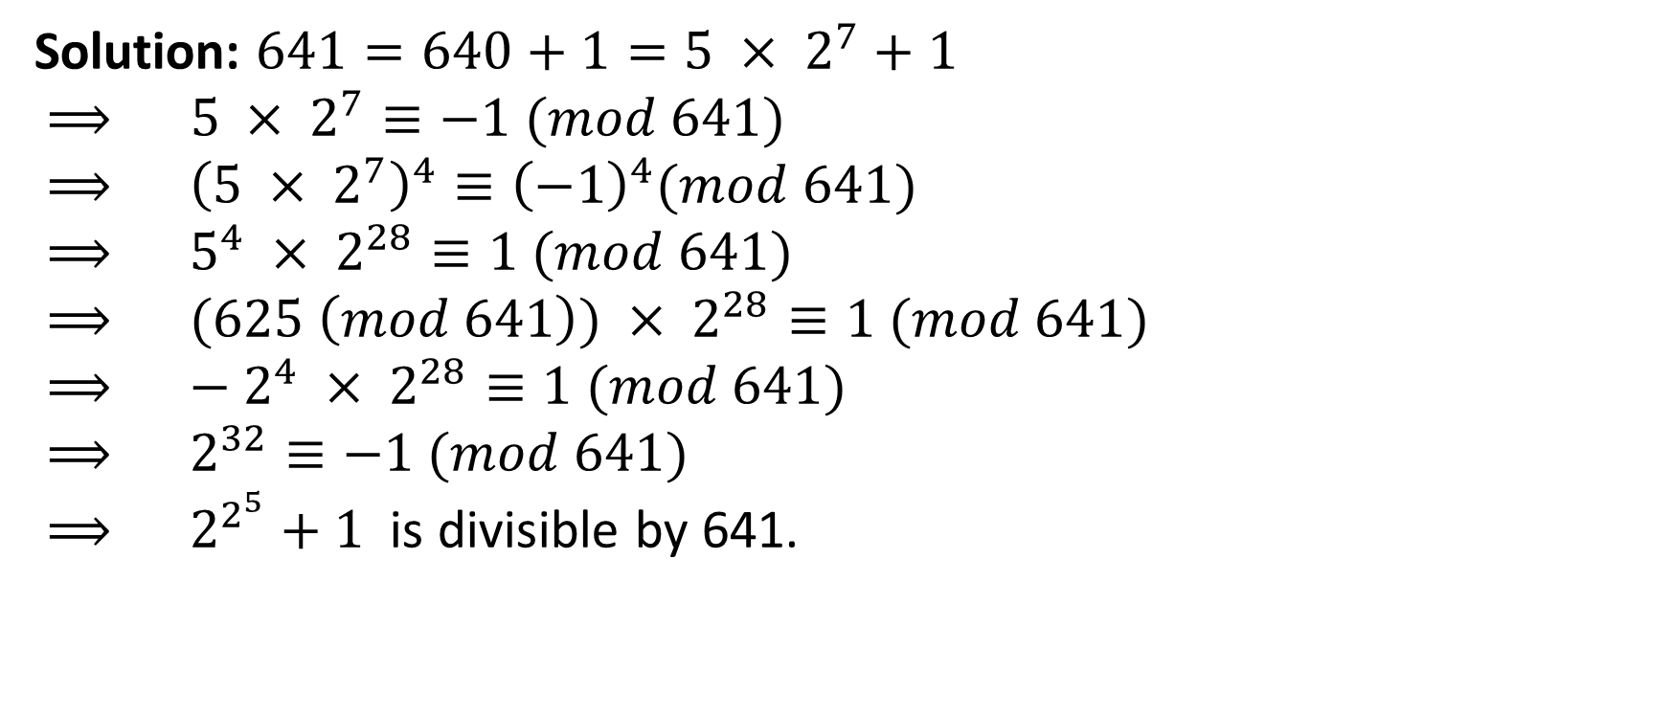
Example
Prove that $2^{2^{5}}$ is divisible by 641.
Solution: $641=640+1=5 × 2^{7}+1$
$⟹ 5 × 2^{7}≡−1 (mod 641)$
$⟹ {\left(5 × 2^{7}\right)}^{4}≡{\left(−1\right)}^{4}(mod 641)$
$⟹ 5^{4} × 2^{28}≡1 (mod 641)$
$⟹ (625 \left(mod 641\right)) × 2^{28}≡1 (mod 641)$
$⟹ {− 2}^{4} × 2^{28}≡1 (mod 641)$
$⟹ 2^{32}≡−1 (mod 641)$
$⟹ 2^{2^{5}}+1$ is divisible by 641.

Slide 18
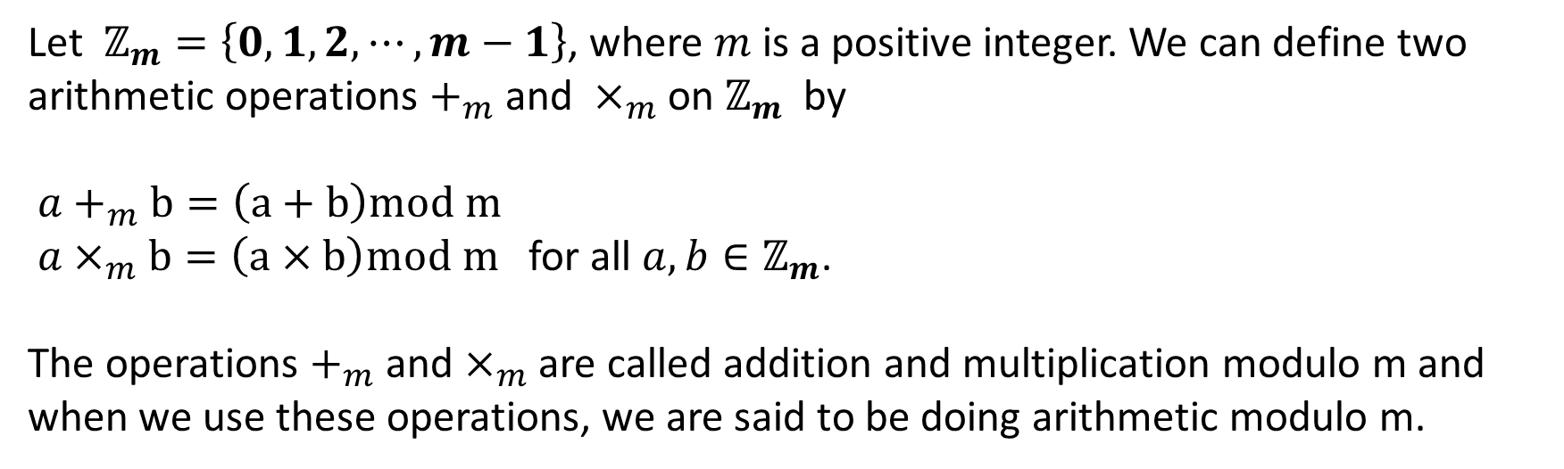

Arithmetic on $ℤ_{m}$
Let $ℤ_{m}=\left\{0, 1, 2, ⋯, m−1\right\}$, where $m$ is a positive integer. We can define two arithmetic operations $+_{m}$ and $×_{m}$ on $ℤ_{m}$ by
$a+_{m}b=\left(a+b\right)mod m$
$a×_{m}b=\left(a×b\right)mod m$ for all $a, b∈ℤ_{m}$.
The operations $+_{m}$ and $×_{m}$ are called addition and multiplication modulo m and when we use these operations, we are said to be doing arithmetic modulo m.
Example: Use the definition of addition and multiplication in $ℤ_{11}$ to find 8$+_{11}9$and 7$×_{11}9$.

Slide 19
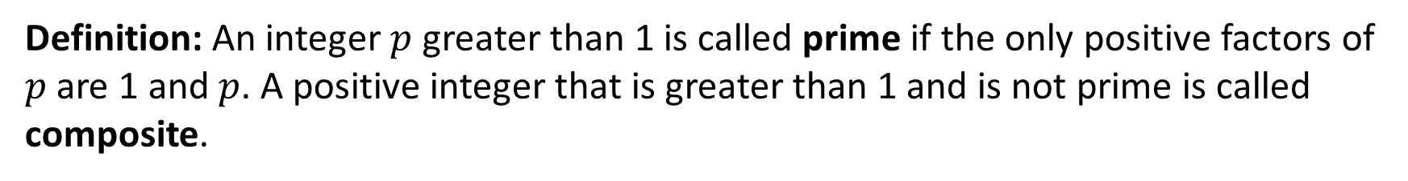
Primes
Definition: An integer $p$ greater than 1 is called prime if the only positive factors of $p$ are 1 and $p$. A positive integer that is greater than 1 and is not prime is called composite.
THE FUNDAMENTAL THEOREM OF ARITHMETIC: Every integer greater than 1 can be written uniquely as a prime or as the product of two or more primes where the prime factors are written in order of non-decreasing size.

Slide 20
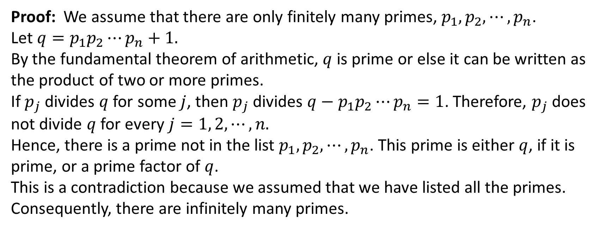
The Set of all Primes is Infinite
Theorem 8: There are infinitely many primes.
Proof: We assume that there are only finitely many primes, $p_{1}, p_{2}, ⋯, p_{n}$.
Let $q=p_{1}p_{2}⋯p_{n}+1.$
By the fundamental theorem of arithmetic, $q$ is prime or else it can be written as the product of two or more primes.
If $p_{j}$ divides $q$ for some $j$, then $p_{j}$ divides $q−p_{1}p_{2}⋯p_{n}=1$. Therefore, $p_{j}$ does not divide $q$ for every $j=1, 2, ⋯, n.$
Hence, there is a prime not in the list $p_{1}, p_{2}, ⋯, p_{n}$. This prime is either $q$, if it is prime, or a prime factor of $q$.
This is a contradiction because we assumed that we have listed all the primes. Consequently, there are infinitely many primes.

Slide 21
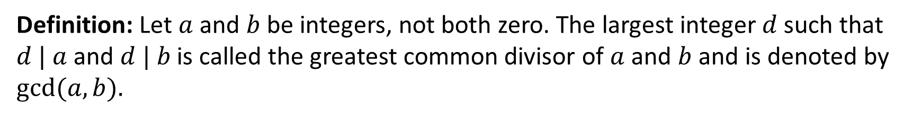
Greatest Common Divisor
Definition: Let $a$ and $b$ be integers, not both zero. The largest integer $d$ such that $d | a$and $d | b$ is called the greatest common divisor of $a$ and $b$ and is denoted by $gcd⁡(a, b).$
Definition: The integers $a$ and $b$ are relatively prime if their greatest common divisor is 1.
Definition: The integers $a_{1}, a_{2}, ⋯, a_{n}$ are pairwise relatively prime if $\gcd\left(a_{i}, a_{j}\right)=1$ whenever $1≤i<j≤ n$.
Example: Integers 17 and 22 are relatively prime, because $gcd⁡(17, 22) = 1.$
Integers 10, 17, and 21 are pairwise relatively prime.

Slide 22
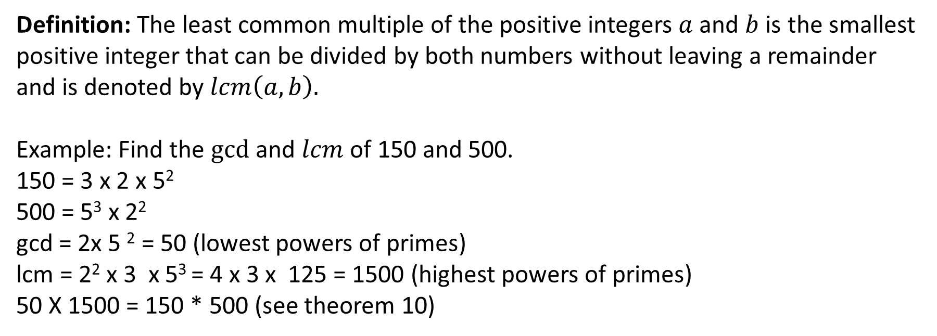
Least Common Multiple
\(\text{LCM}=2^{2}\times 3^{1}\times 5^{3}=4\times 3\times 125=\mathbf{1500}\)
Definition: The least common multiple of the positive integers $a$ and $b$ is the smallest positive integer that can be divided by both numbers without leaving a remainder and is denoted by $lcm\left(a, b\right).$
Example: Find the $gcd$ and $lcm$ of 150 and 500.
150 = 3 x 2 x 5²
500 = 5³ x 2²
gcd = 2x 5 ² = 50 (lowest powers of primes)
lcm = 2² x 3 x 5³ = 4 x 3 x 125 = 1500 (highest powers of primes)
50 X 1500 = 150 * 500 (see theorem 10)
Theorem 10: Let $a$ and $b$ be positive integers. Then $ab=gcd⁡(a, b) · lcm(a, b).$

Slide 23
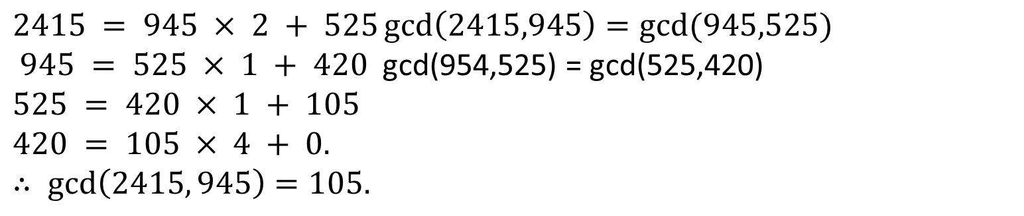
The Euclidean Algorithm
Lemma 11: Let $a=bq+r$, where $a, b, q$, and $r$ are integers. Then $gcd⁡(a, b) =gcd⁡(b, r).$
Example: Let us compute the greatest common divisor of 945 and 2415.
$2415 = 945 × 2 + 525\gcd\left(2415,945\right)=gcd⁡(945,525)$
$945 = 525 × 1 + 420$ gcd(954,525) = gcd(525,420)
$525 = 420 × 1 + 105$
$$420 = 105 × 4 + 0.$$
$$∴ \gcd\left(2415, 945\right)=105.$$

Slide 24
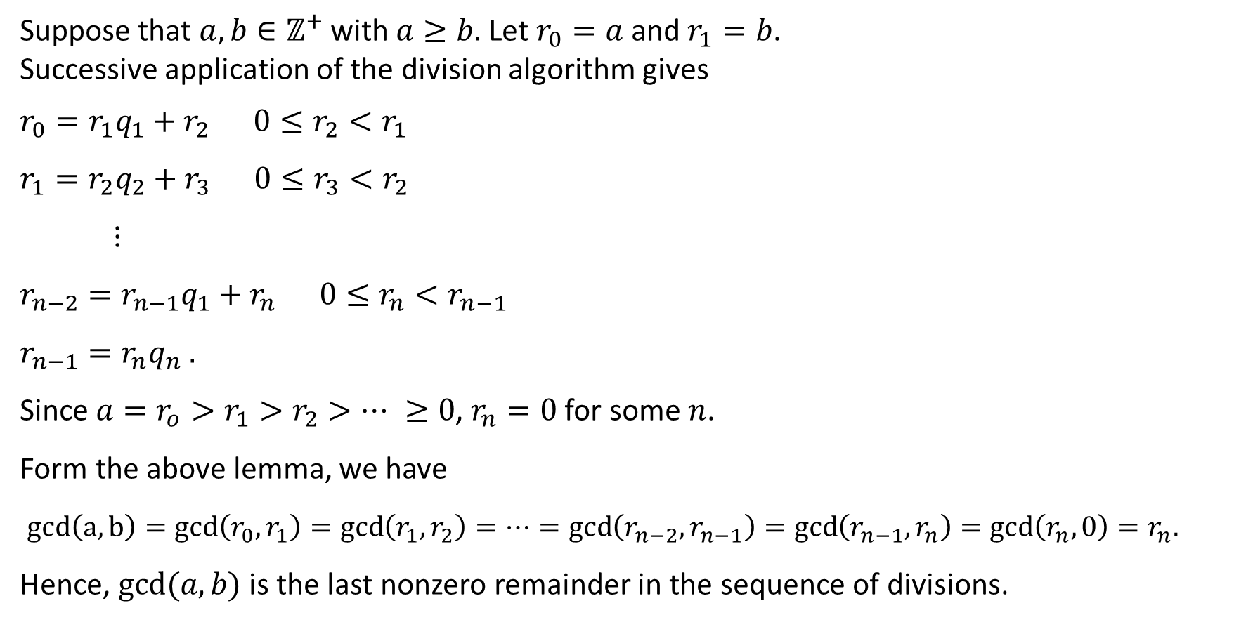
The Euclidean Algorithm
Suppose that $a,b∈ℤ^{+}$ with $a≥b.$Let $r_{0}=a$ and $r_{1}=b$.
Successive application of the division algorithm gives
$r_{0}=r_{1}q_{1}+r_{2} 0≤r_{2}<r_{1}$
$r_{1}=r_{2}q_{2}+r_{3} 0≤r_{3}<r_{2}$
$⋮$
$r_{n−2}=r_{n−1}q_{1}+r_{n} 0≤r_{n}<r_{n−1}$
$r_{n−1}=r_{n}q_{n} .$
Since $a=r_{o}>r_{1}>r_{2}>⋯ ≥0$, $r_{n}=0$ for some $n$.
Form the above lemma, we have
$gcd\left(a,b\right)=\gcd\left(r_{0},r_{1}\right)=\gcd\left(r_{1},r_{2}\right)=⋯=\gcd\left(r_{n−2},r_{n−1}\right)=\gcd\left(r_{n−1},r_{n}\right)=\gcd\left(r_{n},0\right)=r_{n}.$
Hence, $gcd⁡(a,b)$ is the last nonzero remainder in the sequence of divisions.

Slide 25
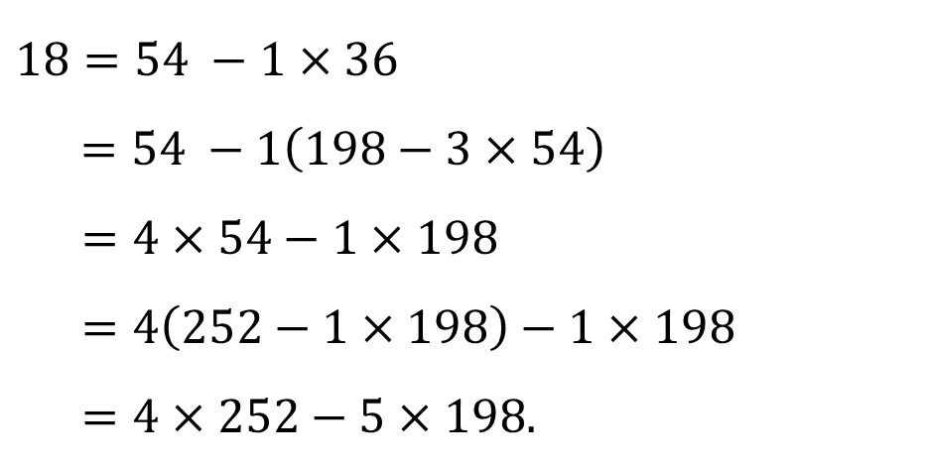
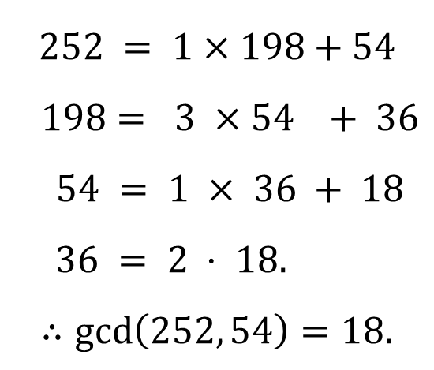
gcds as Linear Combinations
BÉZOUT’S Theorem 12: If $a$ and $b$ are positive integers, then there exist integers $s$ and $t$ such that $gcd⁡(a, b)=sa+tb$.
Example: Express $gcd⁡(252, 198)=18$as a linear combination of 252 and 198.
$$252 = 1×198+54$$
$$198= 3 ×54 + 36$$
$54 = 1 × 36 + 18$
$36 = 2 · 18.$
$$∴\gcd\left(252, 54\right)=18.$$
$$18=54 −1×36$$
$$=54 −1\left(198−3×54\right)$$
$=4×54−1×198$
$=4\left(252−1×198\right)−1×198$
$=4×252−5×198.$
Hence $\gcd\left(252, 198\right)=18=4×252−5×198.$

Slide 26
Applications BÉZOUT’S Theorem
Lemma 13: If $a$, $b$, and $c$ are positive integers such that $gcd⁡(a, b)=1$ and $a|bc$, then $a|c$.
Lemma 14: If $p$ is a prime and $p|a_{1}a_{2}⋯a_{n}$, where each $a_{i}$ is an integer, then $p|a_{i}$ for some $i$.
Theorem 15: Let $m$ be a positive integer and let $a, b,$and $c$ be integers. If $ac≡bc (mod m)$and $gcd⁡(c, m) = 1$, then $a ≡ b (mod m).$

Slide 27
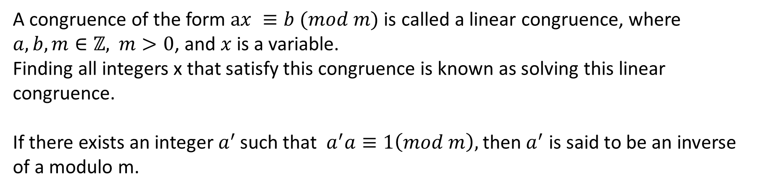
Solving Linear Congruence
A congruence of the form $ax ≡b (mod m)$ is called a linear congruence, where $a,b,m∈ℤ,$ $m>0$, and $x$ is a variable.
Finding all integers x that satisfy this congruence is known as solving this linear congruence.
If there exists an integer $a^{′}$ such that $a^{′}a≡1\left(mod m\right),$ then $a^{′}$ is said to be an inverse
of a modulo m.
Example: What are the solutions of the linear congruence $3x ≡ 4 (mod 7)$?
Theorem 16: Let $m≥2$. If $a$ and $m$ are relatively prime then there exists a unique integer $\overline{a}$ such that $a\overline{a}≡1 (mod m)$ and $0 < \overline{a}<m$.

Slide 28
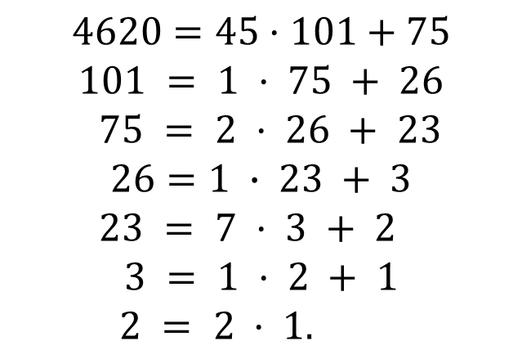
Example
Find an inverse of 101 modulo 4620.
$$4620=45·101+75$$
$$101 = 1 · 75 + 26$$
$$75 = 2 · 26 + 23$$
$$26=1 ∙ 23 + 3$$
$$23 = 7 · 3 + 2$$
$$3 = 1 · 2 + 1$$
$2 = 2 · 1.$

Slide 29

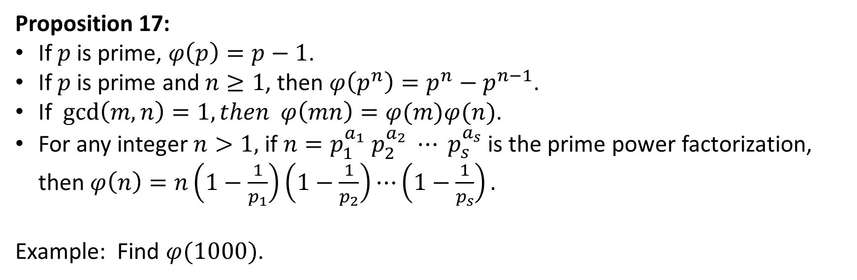
Euler $φ$-function
Definition: The Euler $φ$-function is the function $φ: ℤ^{+}→ℤ^{+}$ defined by
$φ\left(n\right)=$ the number of integers in {1, 2, . . . , n − 1} which are relatively prime to n.
Proposition 17:
If $p$ is prime, $φ\left(p\right)=p−1$.
If $p$ is prime and $n≥1$, then $φ\left(p^{n}\right)=p^{n}−p^{n−1}$.
If $\gcd\left(m,n\right)=1, then φ\left(mn\right)=φ(m)φ(n)$.
For any integer $n>1,$ if $n=p_{1}^{a_{1}} p_{2}^{a_{2}} ⋯ p_{s}^{a_{s}}$ is the prime power factorization, then $φ\left(n\right)=n\left(1−\frac{1}{p_{1}}\right)\left(1−\frac{1}{p_{2}}\right)⋯\left(1−\frac{1}{p_{s}}\right).$
Example: Find $φ(1000)$.

Slide 30
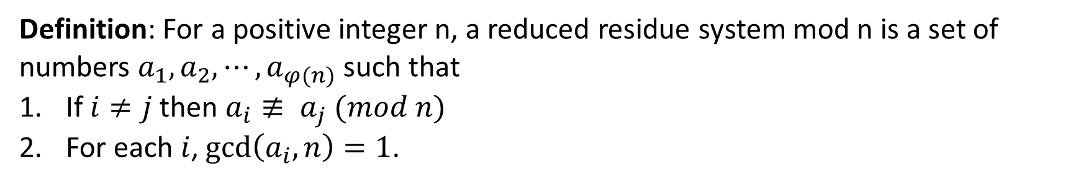
Complete and Reduced residue system
Definition: For a positive integer n, a reduced residue system mod n is a set of numbers $a_{1}, a_{2}, ⋯, a_{φ(n)}$ such that
If $i≠j$ then $a_{i}≢ a_{j} (mod n)$
For each $i$, $\gcd\left(a_{i},n\right)=1$.
Example: $\{1, 5, 7, 11\}$is a reduced residue system mod 12. {−11, 17, 31,−1} is also another reduced residue system for mod 12.
Definition: For a positive integer n, a complete residue system mod n is a set of numbers $\left\{0, 1, 2, ⋯, n−1\right\}$.

Slide 31
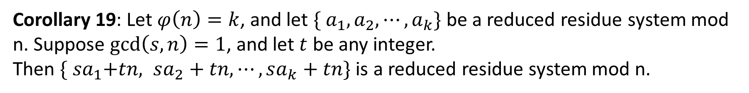
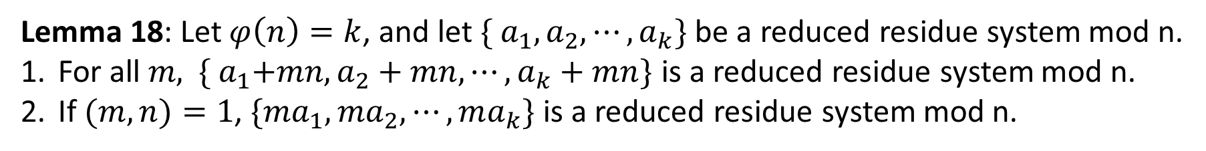
Basic Results
Lemma 18: Let $φ\left(n\right)=k$, and let ${\{ a}_{1}, a_{2}, ⋯, a_{k}\}$ be a reduced residue system mod n.
For all $m,$ ${\{ a}_{1}+mn, a_{2}+mn, ⋯, a_{k}+mn\}$ is a reduced residue system mod n.
If $(m, n)=1$, ${\{ma}_{1}, ma_{2}, ⋯, ma_{k}\}$ is a reduced residue system mod n.
Corollary 19: Let $φ\left(n\right)=k$, and let ${\{ a}_{1}, a_{2}, ⋯, a_{k}\}$ be a reduced residue system mod n. Suppose $\gcd\left(s,n\right)=1$, and let $t$ be any integer.
Then ${\{ sa}_{1}+tn, sa_{2}+tn, ⋯, sa_{k}+tn\}$ is a reduced residue system mod n.

Slide 32
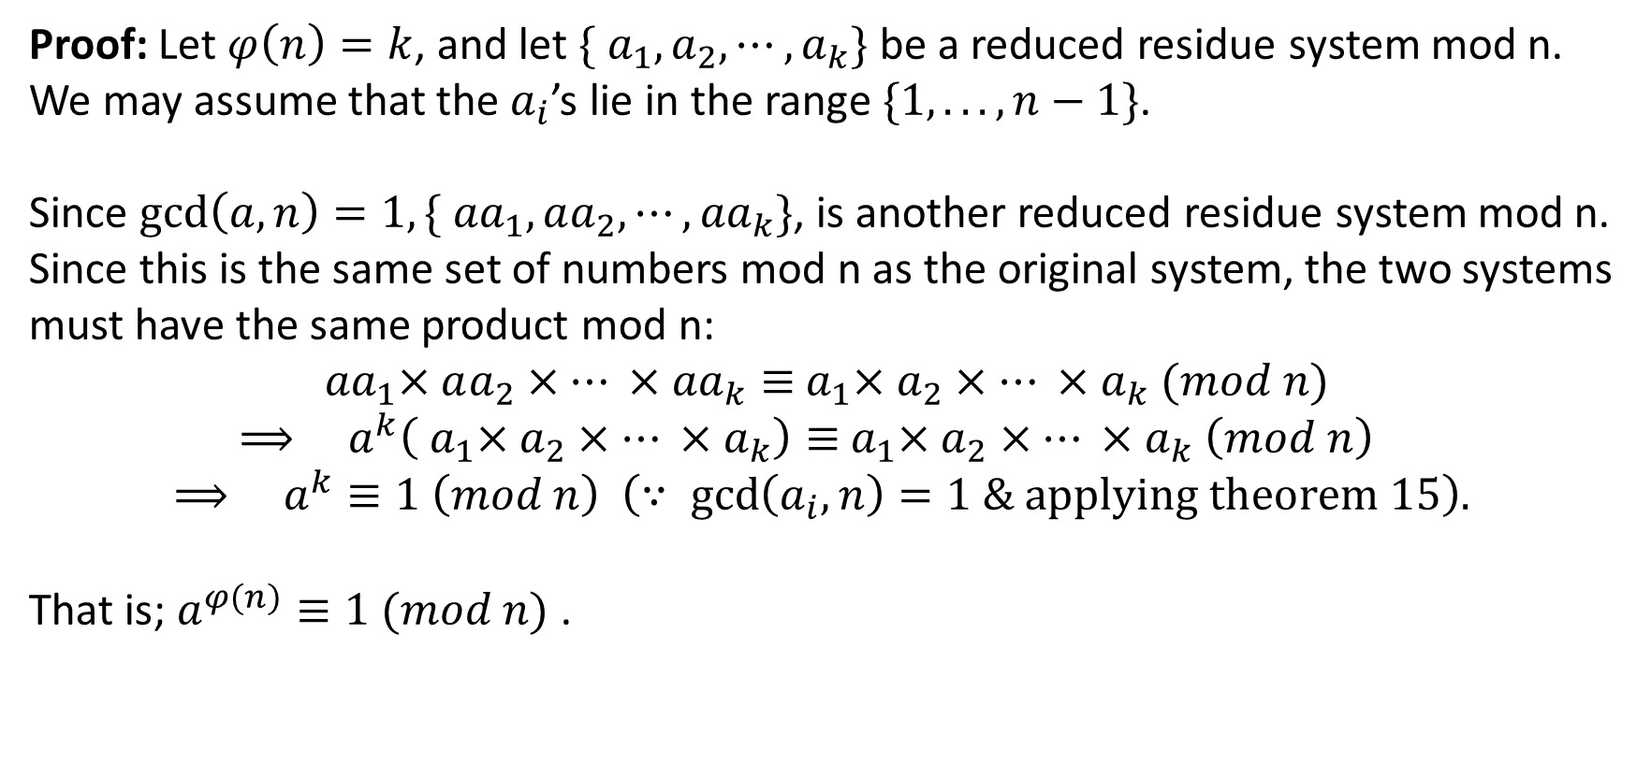
Euler Theorem
Theorem 20: (Euler) Let $n>0, gcd⁡(a, n)=1$. Then $a^{φ(n)}≡1 (mod n)$ .
Proof: Let $φ\left(n\right)=k$, and let ${\{ a}_{1}, a_{2}, ⋯, a_{k}\}$ be a reduced residue system mod n. We may assume that the $a_{i}$’s lie in the range $\{1, . . . , n−1\}$.
Since $\gcd\left(a,n\right)=1,{\{ aa}_{1}, aa_{2}, ⋯, {aa}_{k}\}$, is another reduced residue system mod n. Since this is the same set of numbers mod n as the original system, the two systems must have the same product mod n:
$${ aa}_{1}×aa_{2}×⋯ ×{aa}_{k}≡{ a}_{1}×a_{2}×⋯ ×a_{k} (mod n)$$
$$⟹ a^{k}\left({ a}_{1}×a_{2}×⋯ ×a_{k}\right)≡{ a}_{1}×a_{2}×⋯ ×a_{k} \left(mod n\right)$$
$$⟹ a^{k}≡1 \left(mod n\right) \left(∵ \gcd\left(a_{i},n\right)=1 \& applying theorem 15\right).$$
That is; $a^{φ(n)}≡1 (mod n)$ .

Slide 33
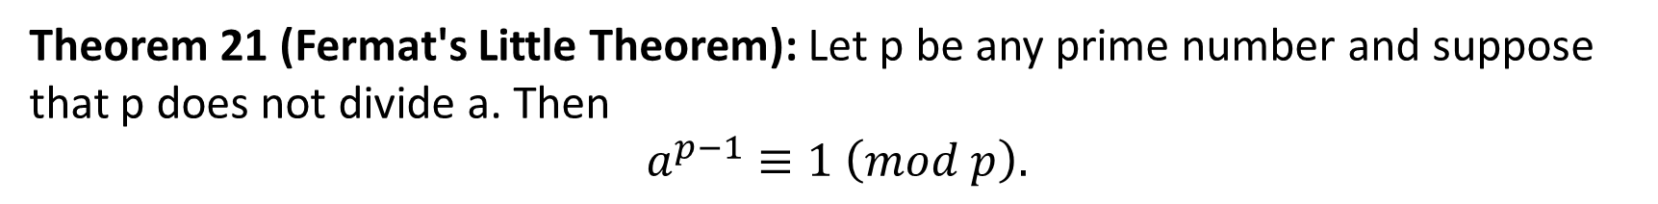
Applications of Euler’s Theorem
Theorem 21 (Fermat's Little Theorem): Let p be any prime number and suppose that p does not divide a. Then
$$a^{p−1}≡1 \left(mod p\right).$$
Example 1: Find $9^{16} mod 40.$
$φ\left(40\right)=16 , and \gcd\left(9,40\right)=1.$Hence by Euler’s Theorem $9^{16}≡1 (mod 40)$.
Example 2: Find $7^{222} mod 11.$
Example 3: Solve $15x≡7 (mod 32).$

